Slide 1



Flexible Grid Access and Demand-Side Flexibility
Lessons from Japan’s Energy Transition
Daiya Isogawa
Professor, Graduate School of Economics
Osaka Metropolitan University, Japan
Session 3a 23/9/2026

Slide 2
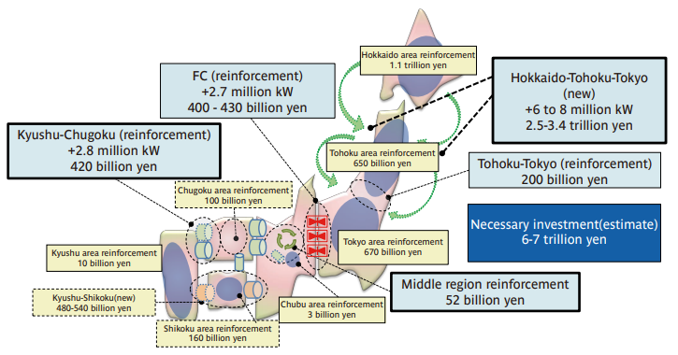
Japan’s Grid Challenge
Decarbonization requires further renewable integration
Renewable potential is often distant from major load centers
New demand may arise from electrification, data centers, and industrial facilities
Grid reinforcement is necessary, but costly and time-consuming
Source: METI/ANRE, Japan Energy 2023, based on OCCTO’s Master Plan, 2023.
Japan needs timely grid investment while making better use of existing network capacity

Slide 3
Regulating Grid Investment
Grid networks are natural monopoly infrastructure
Japan has introduced revenue cap regulation for transmission and distribution utilities
The framework aims to balance:
  Necessary grid investment
  Cost discipline
  Consumer burden through network tariffs
The challenge is balancing timely investment with cost discipline

Slide 4
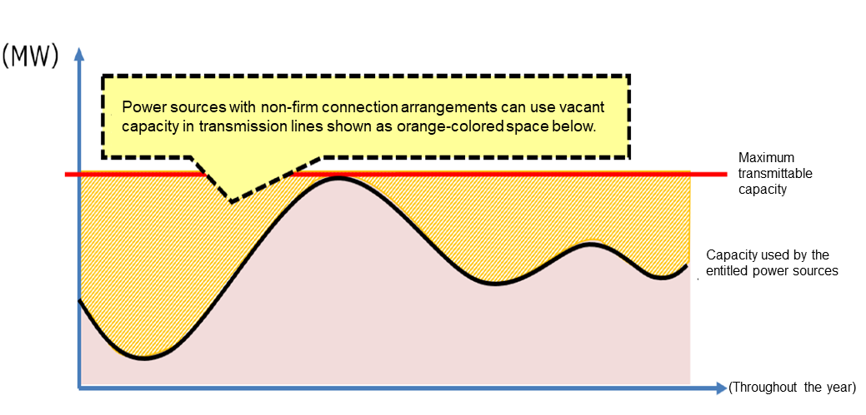
Flexible Use of Existing Grid Capacity
Japan has not adopted full locational marginal pricing
One important approach is non-firm connection: earlier access with curtailment risk
Renewable generators can connect earlier
Output may be curtailed when the network is congested
Source: METI/ANRE, “Efforts to overcome ‘grid constraints’ toward expanding the introduction of renewable energy,” 2022.
Non-firm connection is a pragmatic second-best mechanism for congestion management

Slide 5
Demand-Side Flexibility
Grid reinforcement remains essential
Some network constraints may be addressed through flexibility
Demand response, storage, and flexible loads may:
  Reduce peak demand
  Ease congestion in specific hours or locations
  Defer or better target network reinforcement
Peak load reduction
Lower congestion
Better asset utilization
Flexibility should be evaluated as a complement, not a full substitute, to grid investment

Slide 6
Lessons for Regulators
Plan grid investment proactively, but discipline it through cost-benefit assessment
Use flexible access rules to improve existing network utilization
Evaluate demand-side flexibility and non-wire alternatives in grid planning
Keep network tariffs transparent, predictable, and acceptable to consumers
Efficient grid development requires combining investment, congestion management, flexibility, and transparent tariff design

Slide 7
Thank you!
Concurrent Session 3a:
Energy transition, grid investments and network tariffs
WFER IX · Tbilisi, Georgia

